Slide 1


2020
Netcoreconf
Azure AD MFA + Conditional Access for Developers
Luis Máñez
MVP Office Development
@luismanez
03/10/2020

Slide 2


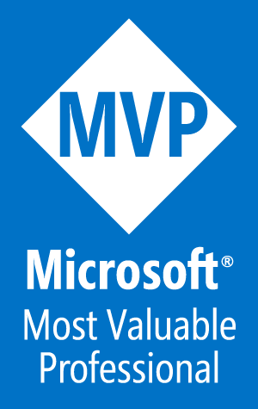
Luis mañez
Chief Architect
ClearPeople LTD (U.K)
https://github.com/luismanez
@luismanez
www.linkedin.com/in/luismanez
Office Development MVP. About 20 years of experience working with Microsoft Technologies. MS Certified specialist in Developing Azure and SharePoint MCPD. Passionate about technology, blogger, technical writer and MS community active member.

Slide 3
Sponsors

Slide 4

Azure AD MFA + Conditional Access for Developers

Slide 5
“Your Pa$$word doesn't matter”
Alex Weinert, Directory of Identity Security at Microsoft

Slide 6
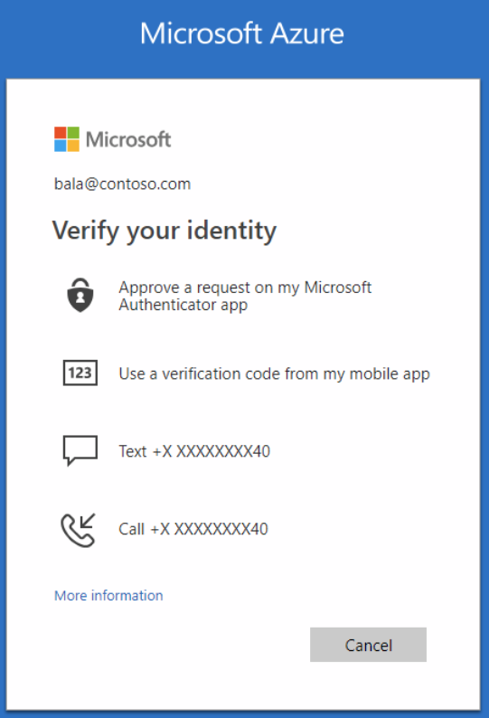

Multi-factor Authentication
Multi-factor authentication is an electronic authentication method in which a computer user is granted access to a website or application only after successfully presenting two or more pieces of evidence (or factors) to an authentication mechanism: knowledge (something the user and only the user knows), possession (something the user and only the user has), and inherence (something the user and only the user is).

Slide 7
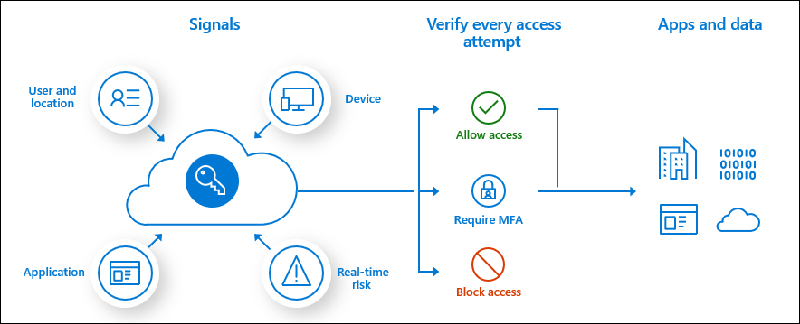
Conditional Access

Slide 8
Common Use Cases
Requiring multi-factor authentication for users with administrative roles
Requiring multi-factor authentication for Azure management tasks
Blocking sign-ins for users attempting to use legacy authentication protocols
Requiring trusted locations for Azure Multi-Factor Authentication registration
Blocking or granting access from specific locations
Blocking risky sign-in behaviors
Requiring organization-managed devices for specific applications

Slide 9

Our Scenario
Delos wants a new app to manage their Parks and Hosts. Most of the functionality will be read operations listing the different Parks they offered, and the Hosts working on them.
If a Host is malfunctioning, the app can claim for a repair, but this action involves the Engineering team, so they want Multi-factor Authentication for that action.

Slide 10

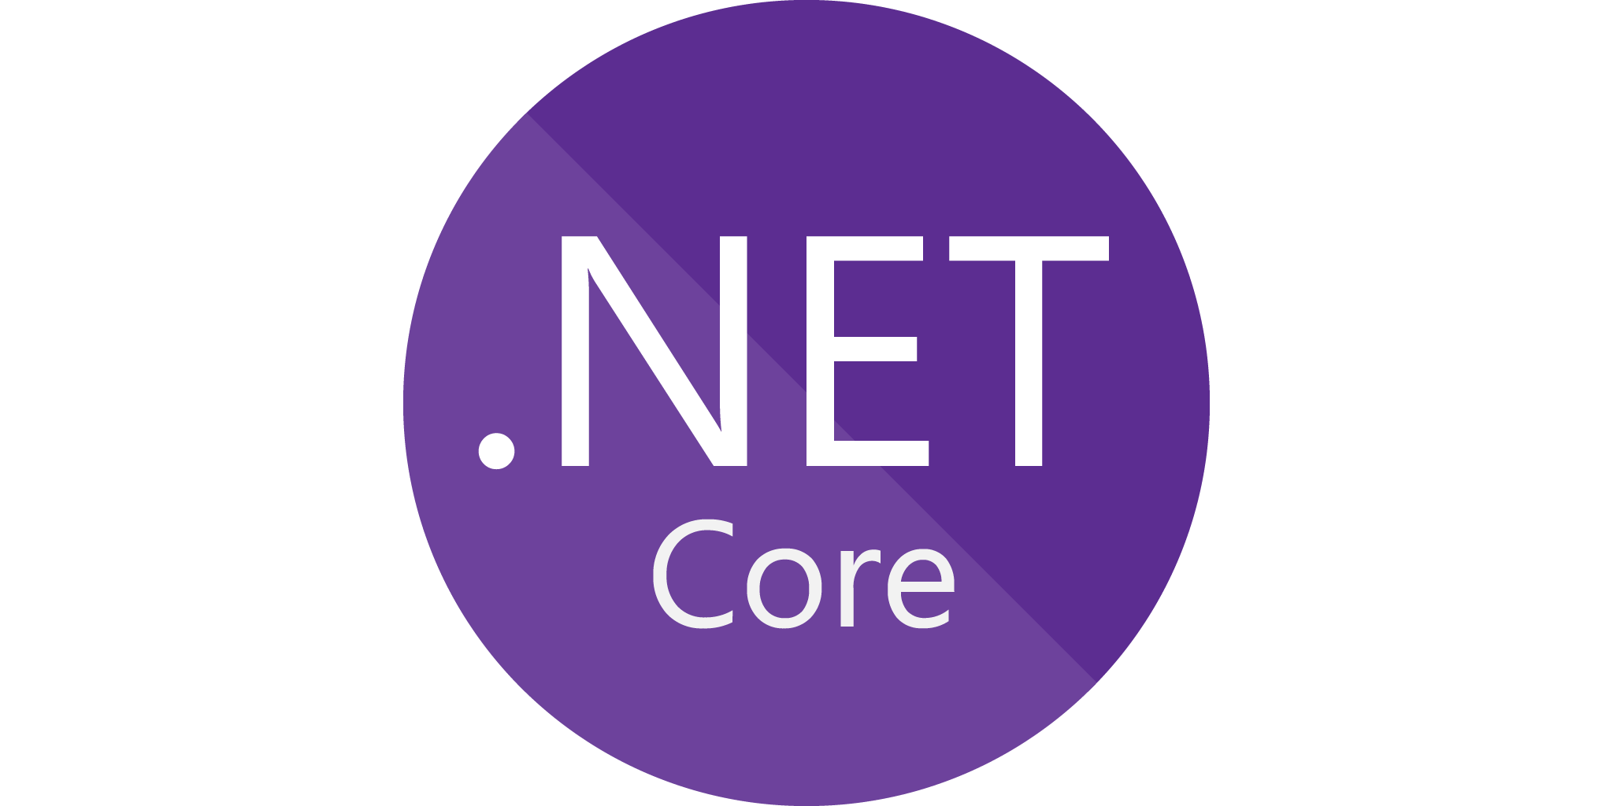



High Level Architecture
graph.
microsoft.com
Azure Active Directory
MFA - CA
Westworld
Web App
Parks
Engineering
End Users
WebAPI
WebAPI

Slide 11

Let´s dive into it!!

Slide 12

Securing Web / Api with Azure Active Directory
Microsoft.Identity.Web.UI
Microsoft.Identity.Web.MicrosoftGraph
This package enables UI for ASP.NET Core Web apps that use Microsoft.Identity.Web.
https://www.nuget.org/packages/Microsoft.Identity.Web.UI/0.4.0-preview
This package enables ASP.NET Core web apps and web APIs to use the Microsoft identity platform (formerly Azure AD v2.0). This package is specifically used for web applications, which sign-in users and call Microsoft Graph, and for protected web APIs that call Microsoft Graph.
https://www.nuget.org/packages/Microsoft.Identity.Web.MicrosoftGraph/0.4.0-preview
Microsoft.Identity.Web
This package enables ASP.NET Core web apps and web APIs to use the Microsoft identity platform (formerly Azure AD v2.0). This package is specifically used for web applications, which sign-in users, and protected web APIs, which optionally call downstream web APIs.
https://www.nuget.org/packages/Microsoft.Identity.Web/0.4.0-preview
Microsoft.Identity.Client
This package contains the binaries of the Microsoft Authentication Library for .NET (MSAL.NET). MSAL.NET makes it easy to obtain tokens from the Microsoft identity platform for developers (formally Azure AD v2.0) signing-in users with work & school accounts, Microsoft personal accounts and...
https://www.nuget.org/packages/Microsoft.Identity.Client

Slide 13

Back to the water!

Slide 14

https://github.com/luismanez/netcoreconfvirtual2

Slide 15

https://docs.microsoft.com/en-us/azure/active-directory/fundamentals/concept-fundamentals-mfa-get-started
https://docs.microsoft.com/en-us/azure/active-directory/conditional-access/overview
https://docs.microsoft.com/en-us/azure/active-directory/develop/msal-overview
https://github.com/AzureAD/microsoft-identity-web
https://github.com/AzureAD/microsoft-identity-web/wiki/Managing-incremental-consent-and-conditional-access
https://github.com/AzureAD/microsoft-identity-web/wiki/customization
https://github.com/microsoftgraph/msgraph-sdk-dotnet

Slide 16
Sponsors

Slide 17
Más información:
info@netcoreconf.com
@Netcoreconf
Visítanos en:
netcoreconf.com
GRACIAS

